Slide 1
ERP Selection Strategy
Kevin Prouty
Research Director,
Enterprise Apps
September, 2011

Slide 2
Research Approach
Background
An ERP selection process is as important as the ERP implementation itself. It sets the foundation for the overall ERP strategy.
Each company must make its selection on its own, but can learn from companies that have been successful at selecting, implementing, and using ERP.
Hypothesis
Companies that are Best-in-Class at using ERP, are also Best-in-Class at selecting the ERP system that best matches their own requirements.
Approach
Electronic survey to all positions inside manufacturing companies
387 responses from the ERP survey; all industries and verticals
Notes:
2

Slide 3
Early Conclusions and Insights
Best-in-Class companies tend to use longer-term selection criteria than others
Top Performing companies typically have more experience with ERP.
Laggard companies are not as organizationally prepared as other companies
Best-in-Class companies are actively engaged with peers for support and guidance
Notes:
3
12/6/2011

Slide 4

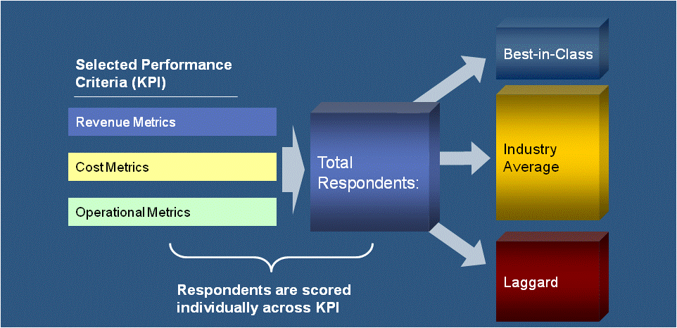
Aberdeen Maturity Class Framework
What are Best-in-Class companies doing differently?
What pitfalls are they avoiding?
Why are they achieving greater success?
What technologies and services are enabling them
to succeed?
Aberdeen’s Methodology
Notes:
4
NC

Slide 5
Best-in-Class Criteria for the right ERP Strategy
Definition of Maturity Class | Mean Class Performance
Best-in-Class: Top 20% of aggregate performance scorers | 33 days sales outstanding 18% operating margin growth 3.1 days to close a month 96% complete and on-time shipments
Industry Average: Middle 50% of aggregate performance scorers | 45 days sales outstanding 10% operating margin growth 5.8 days to close a month 89% complete and on-time shipments
Laggard: Bottom 30% of aggregate performance scorers | 70 days sales outstanding -1% operating margin growth 8.5 days to close a month 78% complete and on-time shipments
Notes:
BIC obviously better than laggards
Laggards are really struggling to get in line for growth

Slide 6
Why should you use a modern ERP system?
Benefit from ERP | Best-in-Class | Industry Average | Laggard | No ERP
Reduction in operating costs | 20% | 13% | 5% | -1%
Reduction in administrative costs | 18% | 10% | 4% | -3%
Reduction in inventory | 22% | 11% | 3% | 1%
Improvement in internal schedule compliance | 18% | 12% | 7% | 0%
Improvement in complete and on-time shipments | 17% | 13% | 5% | 2%
Notes:
BIC obviously better than laggards
Laggards are really struggling to get in line for growth

Slide 7
What are the top three company strategies that impact your ERP strategy?
Notes:
Newer is still better

Slide 8
Typical Selection Process
Business and IT develop top level needs through a steering committee
IT puts together long list of vendors and an RFI
A cross functional selection team builds business case, short list (three vendors), and RFP
A detailed demo is done for each vendor with specific task workers evaluating vendor
The cross functional team makes final recommendation
Notes:
8
12/6/2011

Slide 9
What did you replace or are you replacing:
Distinction between replacement and new to ERP
Replacing ERP
New to ERP

Slide 10
Why are you replacing it?
Specific features, modules, extensions
…out of the box

Slide 11
Best-in-Class top selection criteria:
It’s about the long-term
Notes:
Newer is still better

Slide 12
Do companies have the organization for Best-in-Class ERP?
Sr. management
is committed
Everyone is
involved
Business is
accountable
People are
In place

Slide 13
Do you or will you measure your ERP system?
ERP strategy beyond selection and install
Notes:
BIC Complex vs All others Complex vs All Manufacturers - Enabler

Slide 14
What is your ERP selection strategy?
Peer support for Best-in-Class

Slide 15
User group support
"Working with a user group for an ERP system we were considering, we determined it was not a good fit. The user group saved us significant time and effort."
~ Director of IT, $500M manufacturer of electrical components
Notes:
15
12/6/2011

Slide 16
Questions to continuously ask yourself…
Is your current solution is maintainable with available resources
Is your current vendor stable?
Are you always longing for missing features?
Is your current solution’s infrastructure sustainable?
Would you rather have a root canal than customize your system?
Notes:
16
12/6/2011

Slide 17
Early Conclusions and Insights
Best-in-Class companies tend use longer-term selection criteria than others
Top Performing companies typically have more experience with ERP.
Laggard companies are not as organizationally prepared as other companies
Best-in-Class companies are actively engaged with other companies for support
Notes:
17
12/6/2011

Slide 18

Explore Aberdeen
For more information about our research visit www.Aberdeen.com
Kevin.Prouty@Aberdeen.com
Resources
Notes:
Done

Slide 19





Explore Sage
For more information on Sage, visit www.sageERPsolutions.com or call 866-530-7243
The Business Management Blog
blog.sageerpsolutions.com
Sage ERP on Facebook
facebook.com/sageERP
Sage ERP on Twitter
twitter.com/sageERP
The Sage ERP Channel
youtube.com/sageERPsolutions

Slide 20

Thank You
Conclusion
© AberdeenGroup 2010
20
Notes:
Done

